Slide 1
Welcome to the
Year 10 Introduction to GCSE Evening
Thursday 2nd October 2025
Main Hall

Slide 2
Agenda
7.00-7.20pm Introduction – Dr Newbold
7.20-7.30pm English – Dr Newbold
7.30-7.40pm Maths – Dr Newbold
7.40-7.50pm Science – Mrs Tristem

Slide 3
GCSE Course Guide
Our GCSE Course Guide can be found on our school website the page below:
Link to page

Slide 4
Changes to the GCSEs
New GCSE qualifications were introduced in all subjects from 2017 onwards
These are based on the 9-1 Grade Scale.

Slide 5
What were the key changes?
These specifications:
contain more challenging content
are assessed differently
are graded differently

Slide 6
What were the main changes in assessment?
In most subjects, all assessment (counting towards the final grade) is based on final examinations.
These examinations normally take place at the end of Year 11.
There is not any controlled assessment/ coursework.

Slide 7
A few exceptions
In some subjects there are still some ‘non-examined assessment’:
Art & Design, Dance, DT, Drama, English Language (speaking), Food, PE, Music
BTEC Technical Award Child Development

Slide 8
What were the other main changes in assessment?
In most subjects (apart from Languages, maths and science), all students sit the same exam papers.
There are more challenging command words (e.g. discuss, evaluate).
There are more unstructured (longer) responses.
There is a greater mathematical element (e.g. geography, science)

Slide 9
Grading - the 9-1 Scale
The grading scale changed from A*-G to 9-1 (9 is the highest grade) – and U.
The benchmark for a ‘standard pass’ grade is a Grade ‘4’ (equivalent to a low C).
The benchmark for a ‘strong pass’ is a Grade ‘5’ (equivalent to a high C/ low B).
The old A* grade was divided into two new grades - a Grade 8 or 9.

Slide 10
How does the 9-1 grade scale work?
Current GCSE grades | New GCSE grades
A* | 9 8 7
A
B | 6 5 4
C
D | 3 2 1
E
F
G

Slide 11
Key Academic dates 2025-26
Date | Exams
13 April - 24 April 2026 | Year 10 Mocks
Early January 2027 | Year 11 Mock Exams
Late February 2027 | English 2nd set of Mock Exams
Mid May-Late June 2027 | Final GCSE Exams

Slide 12
Introduction to GCSE English Language and GCSE English Literature
Subject Leader: Hazel Waelend
hwaelend@gillotts.org

Slide 13




English Literature GCSE
Paper 1: 40% 1hr 45 mins
A Christmas Carol
Romeo and Juliet
Paper 2: 60% 2hrs 15 mins
An Inspector Calls
Power and Conflict Poetry
Romeo and Juliet By William Shakespeare - ISBN 1841461229
School provides a copy of the Anthology
A Christmas Carol by Charles Dickens: ISBN 0008325960
An Inspector Calls by J. B Priestley - ISBN 0435232827

Slide 14

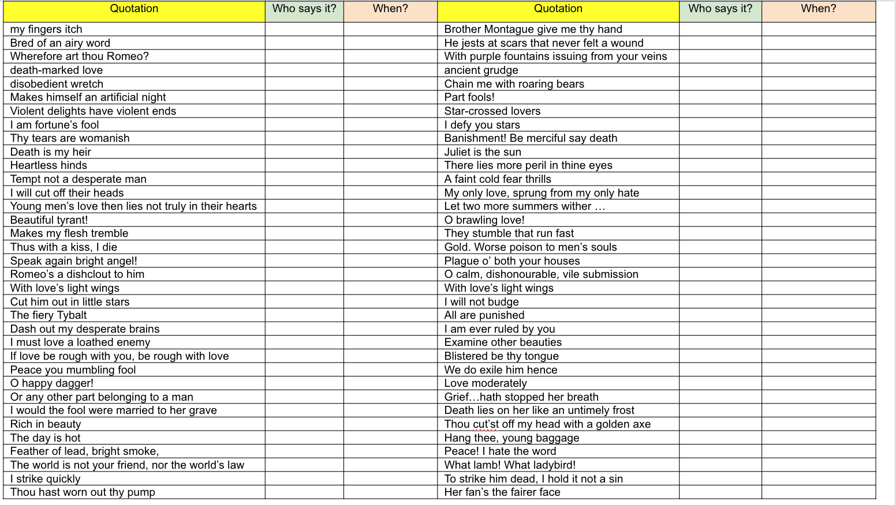
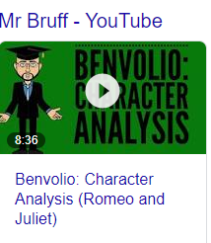
English Literature - Online Revision Resources

Slide 15
How Can you Help: English Literature
Encourage reading for pleasure.
Provide revision cards
Value stories - tell stories about your day, share memories and opinions.
Watch films together and discuss the ideas, characters and message.
Test them on the characters, themes and ideas explored in the books. Ask them to explain the writer’s choice of words, how the tone is created, what the writer’s intention might be.
Visit the Theatre

Slide 16
English Literature - Book Revision Resources
An inspector Calls
An Inspector Calls: AQA Practice Tests with answers (York Notes): - the best way to practise and feel ready for 2022 and 2023 assessments and examsAn Inspector Calls: GCSE Revision Cards for AQA English Literature with free app (GCSE Grades 9-1 Revision Cards): Amazon.co.uk
Romeo and Juliet
York Notes for AQA GCSE (9-1) Rapid Revision: Romeo and Juliet - Refresh, Revise and Catch up!: Revision Cards
Romeo and Juliet AQA Practice Tests: York Notes for GCSE (9-1): - the best way to practise and feel ready for 2022 and 2023 assessments and exams: Amazon.co.uk
Poetry
GCSE English Literature AQA Poetry Workbook: Power & Conflict Anthology (includes Answers): for the 2025 and 2026 exams (CGP AQA GCSE Poetry)
GCSE English: AQA Power & Conflict Poetry Anthology - Revision Question Cards: for the 2025 and 2026 exams (CGP GCSE English Literature Cards): Amazon.co.uk
Unseen poetry
AQA Unseen Poetry Anthology Revision Guide: Ideal for home learning, 2022 and 2023 exams (Collins GCSE Grade 9-1 SNAP Revision): Amazon.co.uk
A Christmas Carol
A Christmas Carol includes Online Edition & Quizzes: for the 2025 and 2026 exams (CGP GCSE English Text Guides)
English Language
Pearson REVISE AQA GCSE English Language: Revision Cards Incl. online revision - for 2025 and 2026 exams: Amazon.co.uk: 9781292182056
Reading Skills Workbook - Targeting Grades 6-9: Get Revision with Results (AQA GCSE English Language and English Literature)

Slide 17

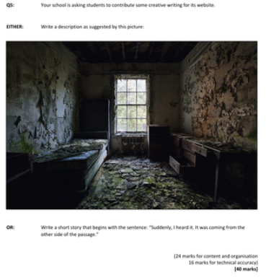
English Language
2 papers both 1 hr 45 mins
Paper 1: Fiction (50%)
Section A Reading one fiction text
Section B Creative writing
Paper 2: Non fiction (50%)
Section A Reading two non-fiction texts
Section B: Transactional writing
“Young people today see little value in exercise.”
Write a speech for your school assembly, stating whether or not you agree with this view

Slide 18




How Can you Help: English Language
Encourage them to read for pleasure
Encourage students to watch the news, read interesting articles, listen to podcasts
Cultivate a curiosity and interest in the world outside of their usual frame of interest
Listen to the radio or podcasts when you are in the car and talk to them about their opinions.
Talk about what is going on in teen world - encourage them to explain new trends, ideas and fads.

Slide 19
Non-examination Assessment: Spoken Language
Consisting:
Presentation
Responding to questions and feedback
Use of Standard English
Assessed:
Marked by teacher
Separate endorsement (0% weighting of GCSE)
Pass, merit or distinction

Slide 20
Homework - Once per week
Exam question
Recall
Research
Assessment: Formal and informal
Termly Assessments - Exam papers
Regular exam questions
Recall

Slide 21
GCSE Maths
Edexcel 1Ma1 Linear
Higher tier grades 4-9
Foundation tier grades 1-5
(Decision on tier of entry in November of y11)
3 papers all 90 mins long
1 = non-calculator
2,3 = Calculator
Subject Leader Miss Frankie Pimentel fpimentel@gillotts.org

Slide 22
How we will be preparing the students
Lessons - content, exam practice and problem solving
Revision Cards
Homework - twice per week
Sparx and shorter exam questions homework
Revision sessions
Regular assessments - formal and informal, end of unit and past papers.
Notes:
Revision sessions will be on Wednesday after school in Y11.
Assessments will be termly and will be in exam conditions (all questions will be similar to Qs in GCSE papers)

Slide 23
How can you help - Homework?
Ensure that your child has WiFi access at home and a quiet place to work.
Check they are completing their Sparx homework in good time
Discuss the use of AI etc …..
Notes:
Sparx is designed to be done little and often. Leaving it all to the night before can be stressful and also a lot of work.
AI is unfortunately being used by students to complete their Sparx homework, Sparx has no way of blocking this. What this means is that the homework will be created to an inappropriate level for them, which means that they will have to continue to use AI to complete it - thus creating a vicious cycle. Teachers can easily spot when AI has been used as the time taken to complete it is near on impossible. Please have conversations with your children at home about the importance of completing Sparx independently, and if they need help, speak to their teacher.

Slide 24
How can you help?
Talk to them about their maths - encourage them to explain new topics to you.
Test them using the revision cards they will be given.
Encourage them to use the revision sessions - particularly in year 11

Slide 25
Maths tutors?
When might you want to use a maths tutor
Ensuring the tier and level of difficulty are correct
Working together
Notes:
Please put the Maths tutor in contact with the class teacher - being able to share details of the SoW and also any areas of development can be incredibly useful.

Slide 26
Equipment they will need
A folder to store papers etc in
Revision cards (Index cards)
A maths set and a scientific calculator (CASIO are easier)
Revision guides - talk to your class teacher
Notes:
Revision guides - teachers can advise an appropriate level

Slide 27
Useful websites
Sparx Maths: Compulsory homework plus independent work - lots of practice questions and videos
Maths Genie: Exam questions grouped by topic and past papers
Corbett Maths: 5-a-day activities, videos, text-book style questions and exam questions

Slide 28




Revision books
2 books at each target grade e.g. Algebra and Shape, Number and Statistics
Talk to your teacher about which ones to buy

Slide 29


OCR 21st Century Science B (9-1)
Chloe Tristem
Subject leader of Science
ctristem@gillotts.org

Slide 30
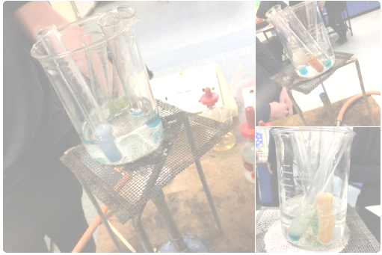
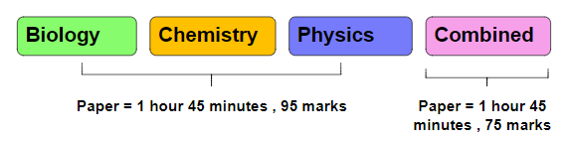
Pathway 1- Combined Science
Awarded 2 GCSEs (5-5, 5-4) | Higher paper (9-4) Foundation paper (5-1) | 8 lessons a fortnight | 1 teacher
Focuses on recall and application with investigation skills

Slide 31
Pathway 2: Triple Science
Awarded 3 GCSEs (independent from each other) | Higher paper (9-4) Foundation paper (5-1) | 13 lessons a fortnight (total for all 3 sciences) | 3 teachers (1 for each science)
Triple science students will sit 6 exams in total at the end of their course (2 for each discipline).
Biology
Chemistry
Physics
Focus on wider recall and application of knowledge across all units
Breadth paper = 1 hour 45 minutes , 90 marks
Focus on practical skills, synoptically linking concepts together
Biology
Chemistry
Physics
Depth paper = 1 hour 45 minutes , 90 marks

Slide 32
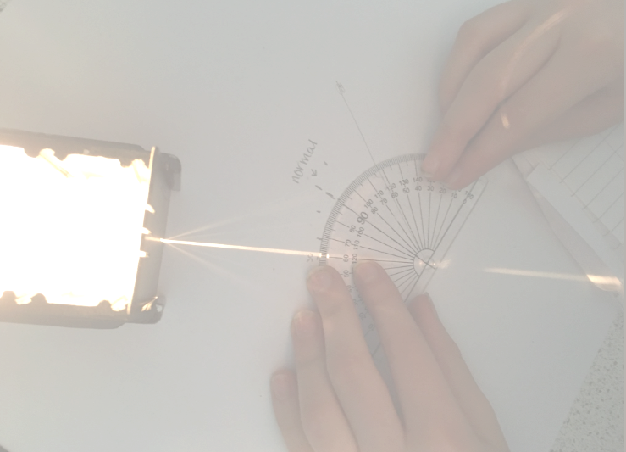


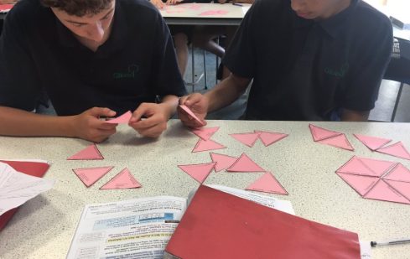

GCSE Curriculum
Biology (6 units)
B1- You and Your Genes
B2- Keeping Healthy
B3- Living Together- Food and Ecosystems
B4- Using Food and Controlling Growth
B5- The Human Body- Staying Alive
B6- Life on Earth: Past, present and future.
Chemistry (6 units)
C1- Air and Water
C2- Chemical Patterns
C3- Chemicals of the Natural Environment
C4- Material Choices
C5- Chemical Analysis
C6- Making Useful Chemicals
Physics (6 units)
P1- Radiation and Waves
P2- Sustainable Energy
P3- Electric Circuits
P4- Explaining Motion
P5- Radioactive Materials
P6- Matter: Models and Explanations
N.B. Students completed unit B1, C1 and P1 in the summer term of Year 9.

Slide 33
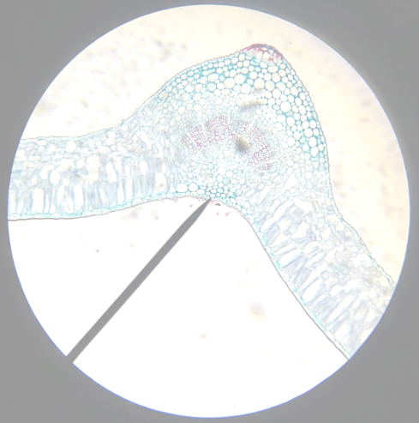
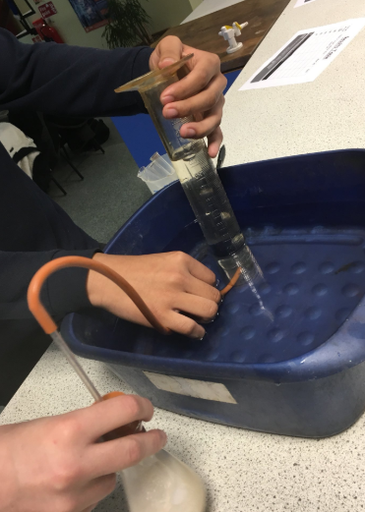
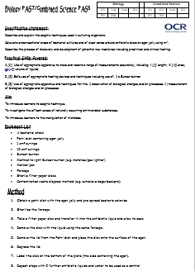
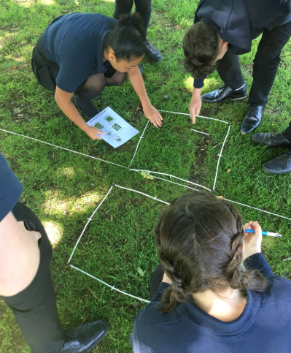
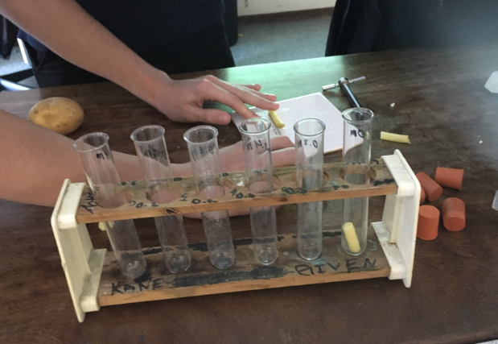
Practical Skills
The ‘old style’ controlled assessment/coursework part of the GCSE courses was phased out (used to be 25% of overall marks).
Practical skills will be embedded into the science curriculum.
These skills will then be examined in their final GCSE exams across all papers.
Students are shown and undertake these experiments in structured lessons which allow for analysis and evaluation.

Slide 34

Science Homework
We have a comprehensive homework programme that runs alongside the science lessons to ensure students are constantly revisiting and being quizzed on material they have covered before.
Task | Activity | Method
LEARN: Consolidation quizzes (10-15 questions long) Once a week | Weekly recap quizzes to consolidate learning covered in science that week/after a sequence of lessons. Develops short term memory.
RECALL practice quizzes (10-30 questions long) Once a week | Weekly recall quizzes to recall prior knowledge and learning from previous lessons/units and years. Develops long term memory.

Slide 35
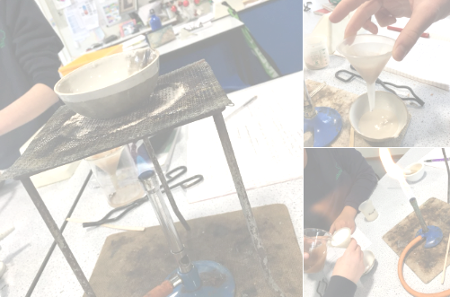

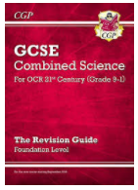

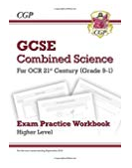
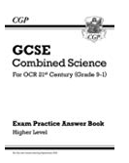


Learning Resources
It is suggested that students purchase a CGP revision guide to support their learning:
CGP Revision Guides/workbooks
Educake Quiz Platform
Cognito Science
BBC Bitesize
Quizlet app
Seneca
Cue cards

Slide 36
Periodic Assessments
Year 10
Date | Biology | Chemistry | Physics | Combined Science
w/b 03.11.25 | B1,B2 | C1,C2 | P1,P2 | B2,C2
w/b 23.02.25 | B1, B2, B3 | C1,C2,C3 | P1,P2,P3 | C2,P2,B3
w/b 13.04.25 (Yr10 Mocks) | B1, B2, B3 | C1,C2,C3 | P1,P2,P3 | B1, B2, B3 C1,C2,C3 P1,P2
Year 11
Date | Biology | Chemistry | Physics | Combined Science
First week back Sep 26 | B1,B2,B3,B4 | C1,C2,C3,C4 | P1,P2,P3,P4 | B4,C4,P3
January 27 (Yr11 Mocks) | B1,B2,B3, B4,B5,B6 | C1,C2,C3, C4,C5,C6 | P1,P2,P3, P4,P5,P6 | B1,B2,B3,B4,B5 C1,C2,C3,C4,C5 P1,P2,P3,P4,P5

Slide 37
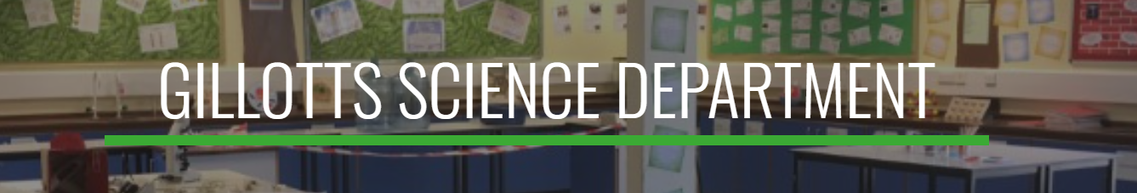

https://sites.google.com/gillotts.org.uk/gillottsscience/ks4-resources/biology
Exam board specification
YouTube revision video playlists
Comprehensive knowledge organisers
Pre-made key word flash cards
Revision resources to suit all learning styles
Past paper question banks
Past paper exams

Slide 38
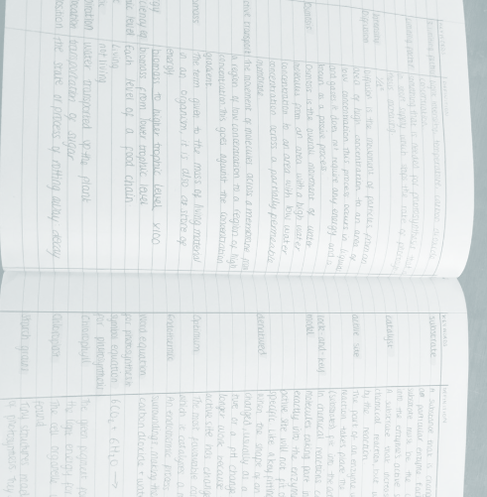

Supporting Students
Whether students have opted for combined science or separate science, it is important that they see the value of obtaining as high a qualification as possible.
Combined science is worth 2 GCSEs remember…
Helpful hints to maximise progress in science…
Discuss work covered in lessons
Look at work completed in exercise books
Check homework is completed via google classroom/Educake
Ask your child to teach you what they have learnt
Encourage independent revision of topics using resources on the Gillotts Science Resource Website
Encourage them to engage with science news (BBC online)

Slide 39
Expectations
Bringing correct equipment
‘Ready to Learn’ – attitude for learning
Resilience
Homework 2 x 45 minutes a week completed to a high standard
Asking for help
Deliberate Practice

Slide 40
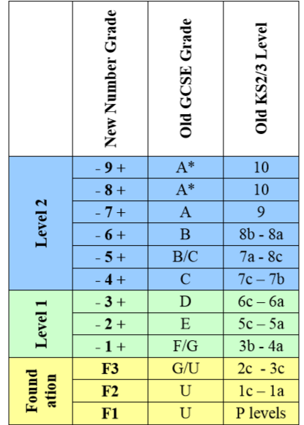
New Grades vs Old

Slide 41
Thank you!
If you have any subject specific questions, please contact your child’s teachers.
If you have more general questions about your child’s progress, please contact their form tutor.

